Slide 1

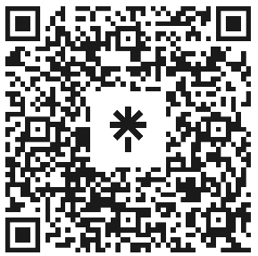

Data Handling
Attendance
linktr.ee/CODE.CRUNCH

Slide 2
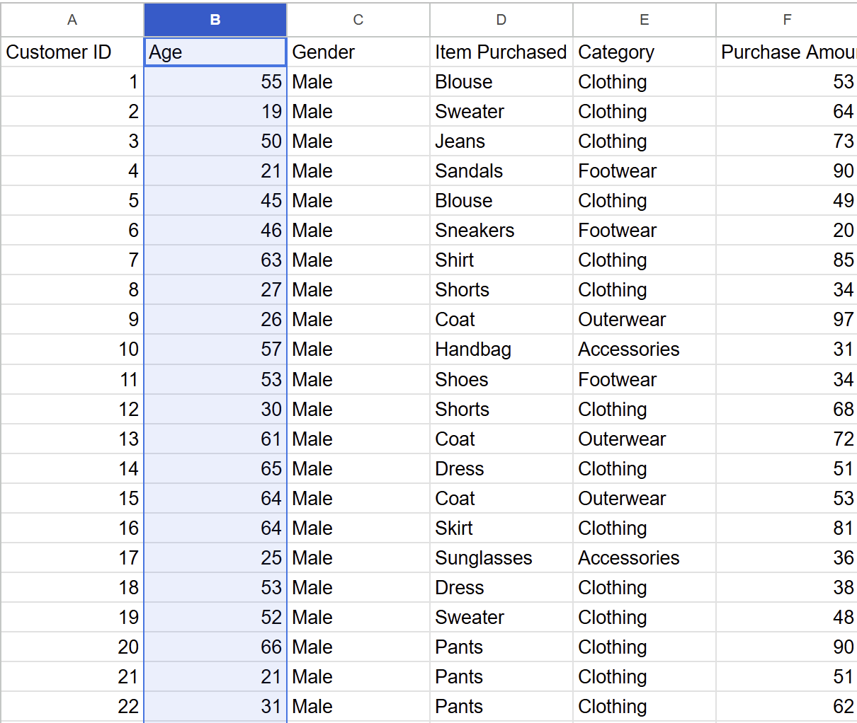
Data Collection
process of gathering and acquiring data from various sources to serve as the foundation for analysis, modeling, and decision-making.
often the first step in the data science workflow.
What is a Dataset?
a collection of information containing features and instances
Instances - an individual data or observational units
often represented as the rows of a data table
Features - variable, characteristic that is measured or observed on an instance
often represented as the columns of a data table

Slide 3
Data Collection cont.
Types of Data:
Structured Data: typically numerical data or quantitative data, and organized in a table
easy to understand by machine learning algorithms
Example: Customer details (name, age, purchase history).
Unstructured Data: abstract data or qualitative data, and may or not be organized in a table
cannot be processed and analyzed through conventional data tools and methods.
Example: text, images, videos, or audio files.
Semi-structured Data: not purely structured, but also not completely unstructured.
meaning not being organized in a table
architecturally contains some level of organization or structure, but does not conform to a rigid schema or data model, and may contain elements that are not easily categorized or classified.
Example: JSON, XML files, or log data.

Slide 4
cont.
Types of Data Values:
Numerical Values: values having mathematical meaning
numbers and vectors
Example:
height
weight
Categorical Feature: non-numerical values or numerical values without mathematical meaning
Example:
yes/no OR 1/0
address

Slide 5
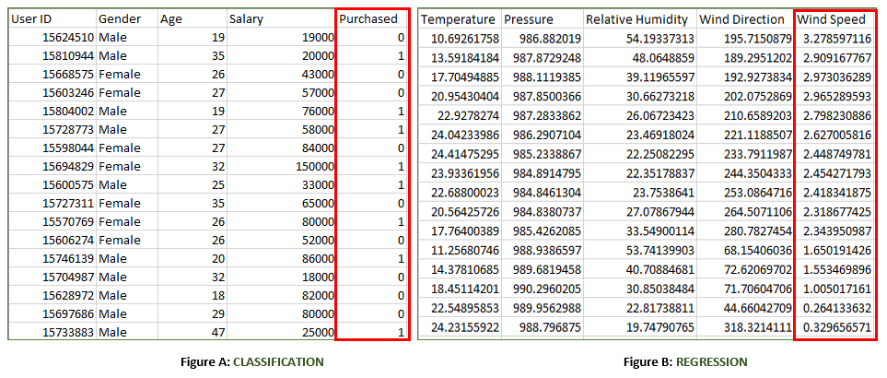
Data for Machine Learning
Types of Machine Learning Models:
Supervised Learning: model is trained on labeled data, meaning the dataset contains both inputs (features) and outputs (labels).
The goal is for the model to learn the mapping from inputs to outputs so that it can accurately predict the output for new, unseen data.
supervised learning tasks:
Classification
regression

Slide 6
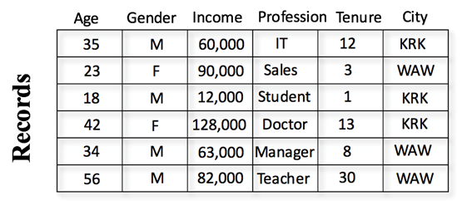
cont.
Unsupervised Learning: model is trained on data without labeled outputs, meaning the dataset contains only input features (no output labels).
The goal is to uncover hidden patterns, structures, or relationships in the data.
unsupervised learning tasks:
Clustering
Dimensionality Reduction
Association
outlier detection detection

Slide 7
Preprocessing for Machine Learning
Train-Validation-Test split:
model training on an entire set of sample data carries the risk of overfitting the sample data, leading to poor performance when predicting beyond the sample
sample data is often split into three subsets:
Training data
validation data
Test data
Determining the data split ratio
Typically you want more training data than validation and testing data
60% - 90% training data
equal split between validation and testing data

Slide 8
Q&A Session

Slide 9





Attendance
Join us for the next sessions
Thursdays: 11AM – 12PM & 2PM – 3PM
Friday: 3PM – 4PM
Monday: 12PM – 1PM
RSVP lu.ma/CODECRUNCH
Your feedback helps us improve. Share your thoughts! Go to our website: go.fiu.edu/codecrunch
linktr.ee/CODE.CRUNCH

